Slide 1


Slide 2


(Using Machine learning algorithms)
Notes:
To change the image on this slide, select the picture and delete it. Then click the Pictures icon in the placeholder to insert your own image.

Slide 3
Content
Introduction
Machine Learning algorithms
Languages Used in this project
Database Connectivity
System Testing
Conclusion
References

Slide 4
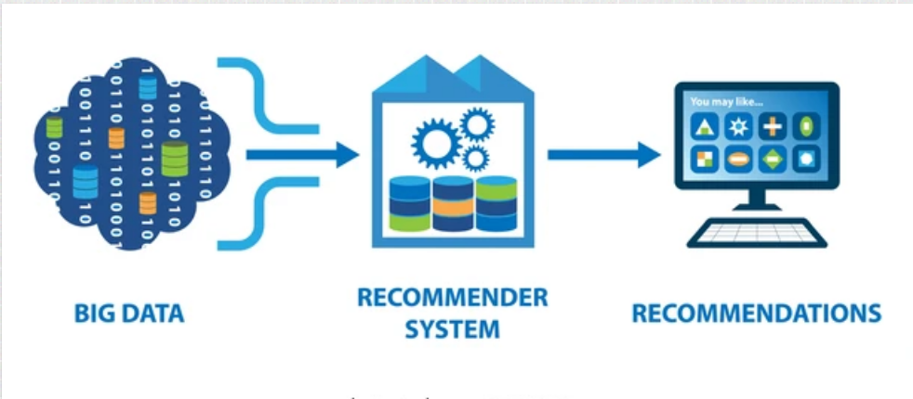
Introduction
A recommendation system is a class of machine learning that uses data to help predict, narrow down, and find what people are looking for among an exponentially growing number of options.
Recommendation systems produce a ranked list of items on which a user might be interested, in the context of his current choice of an item.
Applied in variety of applications like movies, books, research articles etc.

Slide 5
Popularity based & Collaborative Filtering
Popularity-based filtering
Recommends items based on their popularity, or the number of ratings they have. This method is not personalized, so the same recommendations are made to all users.
Collaborative filtering
Recommends items based on the preferences of other users who are similar to the current user. This method uses user-generated content, such as ratings and feedback, to make recommendations.

Slide 6
Language used in this project
In this project, the primary programming language used is Python, along with the Flask web framework for building the web application. Python is a versatile and widely-used language known for its simplicity and readability, making it suitable for both beginners and experienced developers.
Flask is a lightweight and easy-to-use web framework that simplifies the process of building web applications in Python. It provides essential tools for handling HTTP requests, managing routes, and rendering dynamic content.
HTML and CSS: Standard web development languages used for creating the user interface and styling the web pages.

Slide 7

Database Connectivity
In this project we used three datasets.
Books.csv
Ratings.csv
Users.csv
Books.csv which contains Book-Title, Book-Author, Year-Of-Publication, Publisher ,
In users user id, location and age
And ratings.csv which contain user rating.

Slide 8
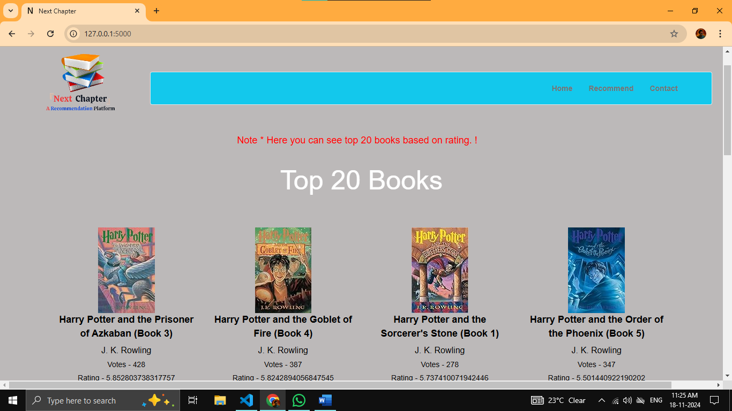
System Testing

Slide 9
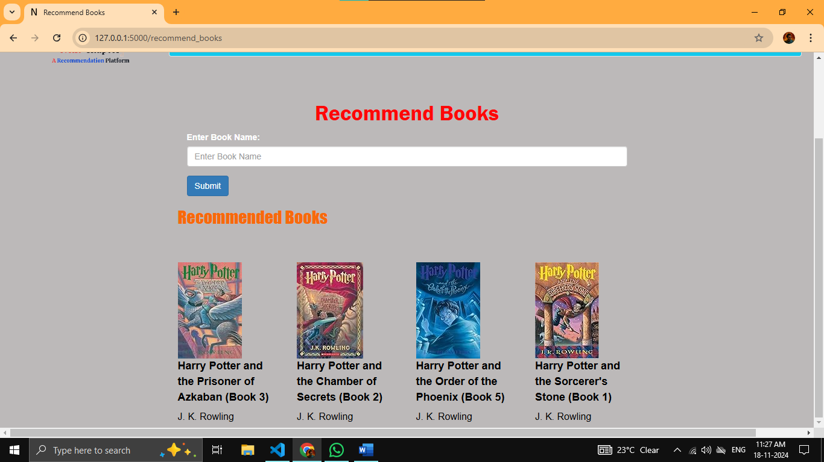
After given input

Slide 10
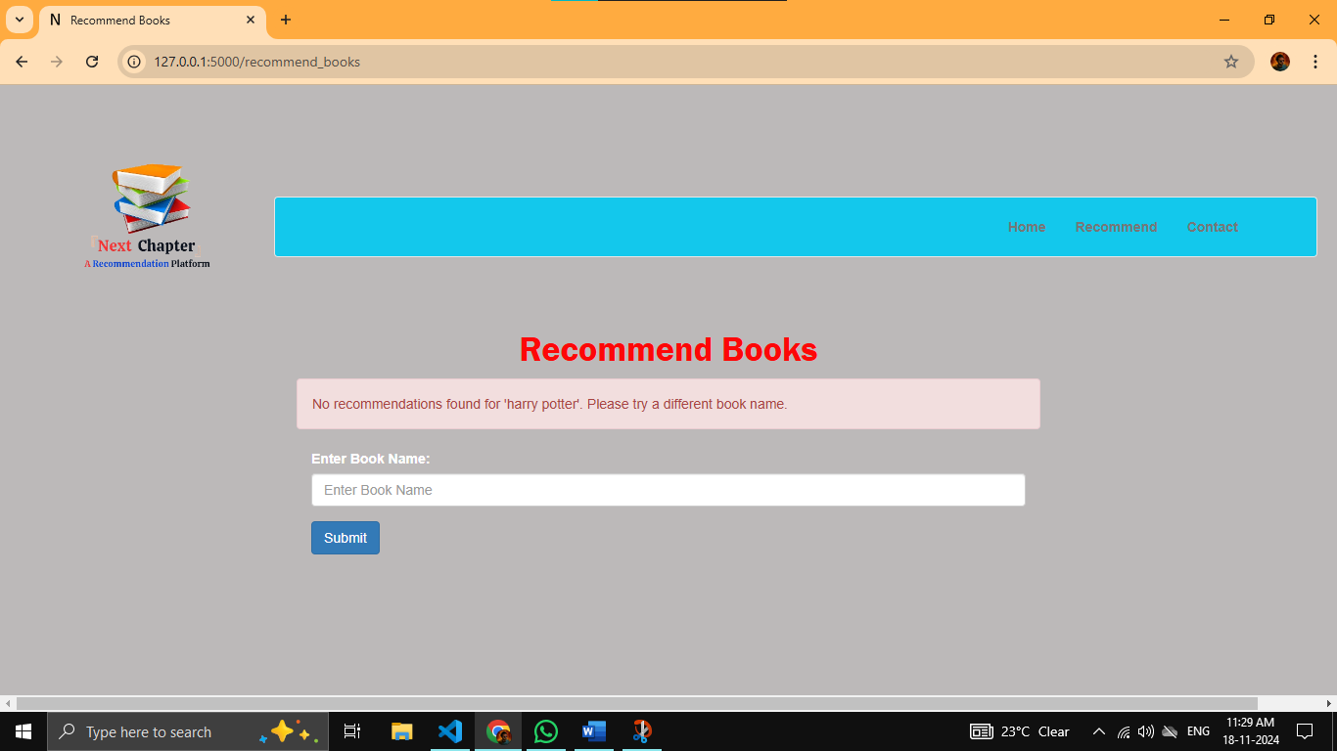
After wrong given input

Slide 11
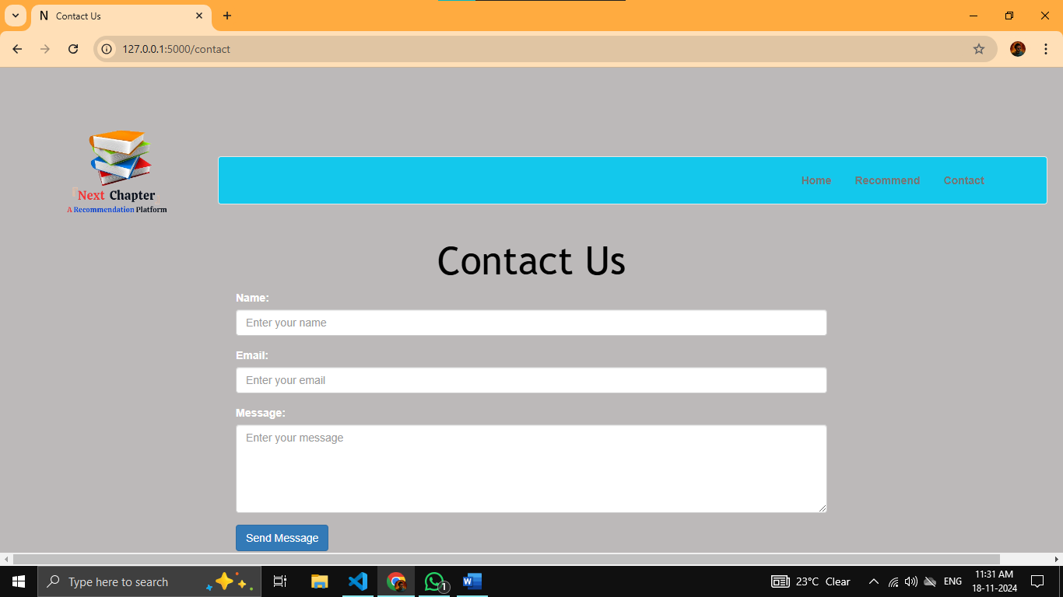
Contact page

Slide 12

Conclusion
The Book Recommendation Platform successfully integrates Popularity-Based Filtering and Collaborative Filtering algorithms to provide a robust and user-centric solution for recommending books. It effectively addresses the challenges of book discovery by catering to diverse user needs—offering globally popular books for general audiences while personalizing suggestions based on individual preferences.

Slide 13

References
https://chat.openai.com/
https://www.kaggle.com/
https://docs.streamlit.io/
https://jupyter.org/
https://code.visualstudio.com/

Slide 14


